Slide 1
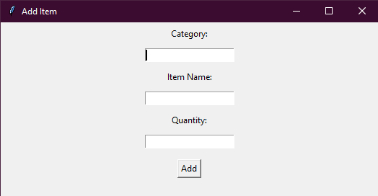
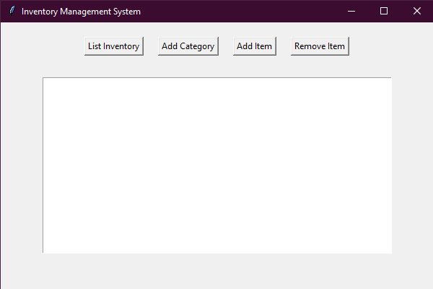

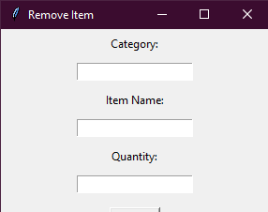
Simple Inventory Tracker
Effortless Inventory Management for a Smarter Business Workflow
Michael Nwadike
Version 0.60

